Slide 1
Unit 5 - Introducing Business Intelligence Applications
Outcome: Explain analytical tools and reporting tools for Business Data Analysis

Slide 2
Importance of B.I. Application
Business intelligence overview
What Is Business Intelligence?
Business intelligence refers to a collection of mathematical models and analysis methods that utilize data to produce valuable information and insight for making important decisions.
Main Components of Business Intelligence System:
Data Source
Data Mart / Data Warehouse
Data Exploration
Data Mining
Optimization
Decisions

Slide 3
Types of Business Intelligence Tools
BI tools come in a wide variety of forms. Let us discuss some of them:
Spreadsheets: Spreadsheets, such as Google Docs and Microsoft Excel, are a widely used BI tool.
Reporting Software: Reporting software is used to filter, organize, display, and report data.
Data Visualization Software: Data visualization software are used to transform datasets into easily-readable, visually-appealing graphical illustrations to help with quick insights.
Data Mining Tools: Data mining tools help mine data for recognizable patterns. This is done by using machine learning, statistics, and AI.
Online Analytical Processing (OLAP): OLAP helps users analyze datasets based on various business perspectives.

Slide 4
Business Intelligence Applications
There are a lot of applications that are used in BI. Here are some of them:
Ad Hoc Analysis
It is also known as ad hoc querying. It is an important feature in modern BI applications. In ad hoc analysis, queries are written and run to analyze specific business-related issues. The analytic results find their way into dashboards and reports.
Mobile BI
It helps make BI applications available on mobile devices. These are designed for ease of use and are mostly used to view data rather than analyze it.
Real-time BI
It analyzes data as it is collected, created, and processed. This gives users an updated view of all areas of interest.
Operational Intelligence (OI)
It is a type of real-time analytics that is responsible for delivering information to managers and frontline workers. These applications are created to help in operational decision-making.

Slide 5
Benefits of BI
speed up and improve decision-making;
optimize internal business processes;
increase operational efficiency and productivity;
spot business problems that need to be addressed;
identify emerging business and market trends;
develop stronger business strategies;
drive higher sales and new revenues; and
gain a competitive edge over rival companies.

Slide 6
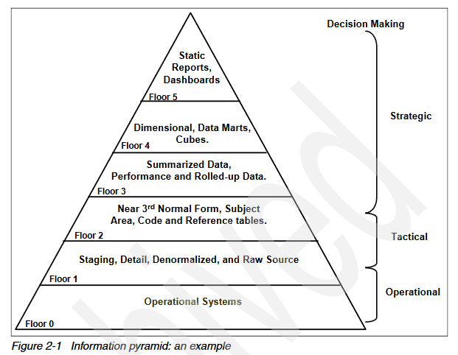
Information environment

Slide 7
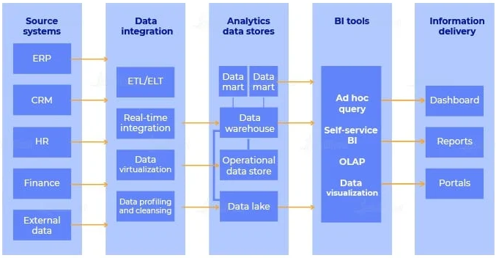
Business Intelligence Architecture

Slide 8
Business Intelligence Techniques
Data Visualization
Data stored as a set or matrix can be difficult to interpret. It is difficult to tell if the sales are going up or down, or whether they are steady. This becomes even harder if one is dealing with more than one dimension of data. The visualization of data in charts makes it convenient to quickly understand and interpret data.
Data Mining
Data mining is a computer-aided process that unveils relationships between data entities that were not known before.
Reporting
Designing, scheduling, and generating reports is essential in BI. These reports majorly help in collecting and presenting the information to help management, planning, and decision-making.

Slide 9
Time-series Analysis Including Predictive Techniques
The changes in user behavior in time, the relationship between products, the changes in sale contracts, etc., are all important. These could help in future predictions of trends.
Statistical Analysis
In statistical analysis, the mathematical foundations are utilized to validate the significance and reliability of all observed relationships.

Slide 10
Differences Between Business Intelligence and Business Analytics
Business Intelligence | Business Analytics
Uses available data to analyze past patterns to make operations easy | Analyzes past trends to make predictive analysis and future forecasts
Solves immediate problems | Is future-focused
Strategic in nature | Tactical in nature
Used for reporting key performance indicators (KPIs) and metrics | Used for statistical and quantitative analysis
Automated monitoring and alerts | Data mining and text mining

Slide 11
BI list of design requirements, including:
Be correct. BI applications must provide accurate audit reports and document differences compared to other systems.
Perform well. A response time of less than five seconds for the average query is a good goal.
Be easy to use. Users who have enough skill to order a book online should be able to use at least the standard reports. Getting customized results with less than ten mouse clicks is a good goal.
Look good. Tools and reports should be clear and attractive.
Be a long-term investment. Applications must be properly documented,
maintained, enhanced, and extended

Slide 12
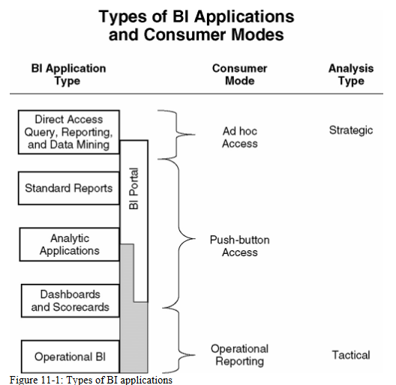

Slide 13
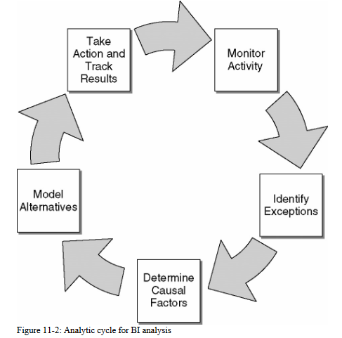
Analytic Cycle for Business Intelligence
Stage 1: Monitor Activity
BI application requirements in the monitor activity stage focus on the presentation layer and include technologies such as
dashboards, portals, and scorecards. Many data warehouse implementations stop at this stage and declare success.
Stage 2: Identify Exceptions
This stage focuses on the identification of "what's the matter?" or "where are the problems?" The emphasis in this stage is to identify the exceptions to normal performance, as well as the opportunities
The identify exceptions stage requires additional capabilities, such as distribution servers that distribute alerts to users' devices of choice based upon exception triggers and visualization tools to view the data in different more creative ways, including trend lines, spark lines, geographical maps, or clusters

Slide 14
Analytic Cycle for Business Intelligence
Stage 3: Determine Causal Factors
This stage tries to understand the "why" or root causes of the identified exceptions.
Identifying reliable relationships and interactions between variables that drive exceptional performance is the key.
Successfully supporting users' efforts in this stage
will require your DW/BI system architecture to include additional software including
statistical tools and/or data mining algorithms, such as association, sequencing,
classification, and segmentation, to quantify cause-and-effect. This step frequently
requires new data to investigate causal factors

Slide 15
Analytic Cycle for Business Intelligence
Stage 4: Model Alternatives
In this stage, you build on cause-and-effect relationships to develop models for
evaluating decision alternatives.
Stage 5: Take Action and Track Results
Ideally, you can enable a closed loop process in your BI applications and feed the
recommended actions back to the operational system. The take action/track results
stage places additional demands on your data warehouse architecture. You need to
access operational systems from the data warehouse via APIs or SOA calls.
Technologies applicable in this area include distribution services that enable users to respond with recommended actions from email, PDAs, pagers, or cell phones, not just deliver alerts

Slide 16
Analytic Cycle for Business Intelligence
More Implications of the Analytic Cycle
The analytic cycle helps us understand how business users will use the DW/BI system and what tools we must provide to make their experience as simple and seamless as possible.
It provides a framework for analysis that underlies all analytic activity from the five minute quick query to the five week marketing program review.

Slide 17
Analytic Cycle for Business Intelligence
Goals
• Proactively guide business users beyond basic reporting.
• Identify and understand exceptional performance situations.
• Capture decision-making "best practices" for each exceptional performance situation.
• Share the resulting "best practices" or intellectual capital across the organization

Slide 18
Types of Business Intelligence Applications
Direct access query and reporting tools
allow users to query the dimensional model directly and define a results set.
Simple ad hoc tools only deliver tabular results sets, whereas more advanced tools allow the creation of fully realized, complex reports.
In these cases, the ad hoc tools also serve as the development tools for standard reports that other users run themselves.

Slide 19
Direct Access Query Tools Capabilities
Query Formulation
Multipass or multiset queries.
Alerts
Successive constraints
Semi-additive summations
ANSI SQL 99 support
Direct query string entry

Slide 20
Direct Access Query Tools Capabilities
Analysis and Presentation Capabilities
Basic calculations on the results set
Pivot the results
Drill down
Column calculations on pivot results
Column and row calculations.
Sorting
Complex formatting.
Charting and Graphs
User changeable variables

Slide 21
Direct Access Query Tools Capabilities
User Experience
Easy to use
Meta data access
Pick list
Seamless integration with other applications.
Export to multiple file types.
Embedded queries

Slide 22
Direct Access Query Tools Capabilities
Technical Features
Multitasking
Cancel queries
Scripting
Connectivity
Scheduling
Metadata driven
Software administration
Security
Quering

Slide 23
Direct Access Query Tools Capabilities
Standard Reports
Some typical examples of standard report titles might be:
YTD Sales vs. Forecast by Sales Rep
Monthly Churn Rate by Service Plan
Five-Year Drop Out Rate Time Series by School
Direct Mail Response Rates by Promotion by Product
Audience Counts and Percent of Total Audience by Network by Day of Week and Time of Day
YTD Claims vs. Forecast by Vehicle Type
Call Volume by Product as a Percent of Total Product Sales

Slide 24
Direct Access Query Tools Capabilities
Analytic Applications
Common analytic applications include:
Promotion effectiveness
Web path analysis
Affinity program analysis
Shelf space planning
Fraud detection
Sales force management
Category management

Slide 25
Direct Access Query Tools Capabilities
Pre-Built Analytic Applications
Read/Write Analytic Applications

Slide 26
Direct Access Query Tools Capabilities
Dashboards and Scorecards
Operational Business Intelligence
Data Mining
Data Mining Overview
Data mining is a process of data exploration with the intent to find patterns or relationships that can be made useful to the organization. Data mining takes advantage of a range of technologies and techniques for exploration and execution.

Slide 27
Direct Access Query Tools Capabilities
Clustering
Clustering is a pure example of undirected data mining, where the user has no specific agenda and hopes that the data mining tool will reveal some meaningful structure
Classifying
An example of classifying is to examine a candidate customer and assign that customer to a predetermined cluster or classification; for example, assigning each customer to an interest level with discrete values of disinterested, casual, moderate, active, or eager might be part of a sales force automation application.

Slide 28
Direct Access Query Tools Capabilities
Estimating and Predicting
Estimating and predicting are two similar activities that normally yield a numerical measure as the result.
Anomaly Detection
Several business processes rely on the identification of cases that deviate from the norm in a significant way.
Fraud detection in consumer credit is a common example of anomaly detection.

Slide 29
Direct Access Query Tools
Real-Time Data Access: Tools like DirectQuery in Power BI allow users to connect directly to data sources, ensuring that the data is always up-to-date¹.
Complex Query Handling: SQL Server Analysis Services (SSAS) and similar tools can handle complex queries, providing detailed insights from large datasets¹.
Data Integration: These tools can integrate data from various sources, including databases, cloud services, and flat files, providing a unified view of the data

Slide 30
Reporting Tools
Interactive Dashboards: Tools like Tableau and Power BI enable the creation of interactive dashboards that allow users to explore data visually and gain insights quickly².
Customizable Reports: Users can create customized reports tailored to specific business needs, making it easier to track key performance indicators (KPIs) and other metrics³.
Automated Reporting: Many BI tools support automated report generation and distribution, ensuring that stakeholders receive timely updates without manual intervention

Slide 31
Additional Capabilities
Data Visualization: Advanced visualization options help in presenting data in an easily understandable format, highlighting trends and patterns².
Natural Language Processing (NLP): Some tools, like Tableau, support NLP, allowing users to query data using natural language, making it more accessible to non-technical users².
Performance Management: BI tools often include features for performance management, helping organizations monitor and improve their operational efficiency

Slide 32
Types of Business Intelligence Applications
Data mining is included in the direct access box because often a small set of statistical analysts use data mining tools to explore the data in the warehouse for useful patterns and relationships.
The resulting models are often embedded in other BI applications. Because data mining is rarely seen by most users, we will hold off on its description until later in this section.

Slide 33
Types of Business Intelligence Applications
Standard reports are predefined, preformatted reports that generally provide some level of user interaction, like the ability to enter a parameter, drill down to a lower level of detail, and link to related reports.
Analytic applications are managed sets of reports that usually embed domain expertise regarding the analysis of a particular business process.
Most analytic applications require an interface layer for user access. Analytic applications often take advantage of data mining models

Slide 34
Types of Business Intelligence Applications
Dashboards and scorecards generally involve a combination of reports and charts that use exception highlighting and drilldown capabilities to analyze data from multiple business processes.

Slide 35
Types of Business Intelligence Applications
Operational BI and closed loop applications include the use of applications that are more sophisticated than typical operational reports.
These applications leverage the rich historical context across multiple business processes available in the data warehouse to guide operational decision making.
Operational BI applications often include data mining models to help identify patterns and opportunities at the operational level.
These applications also frequently include transactional interfaces back to the source systems

Slide 36
Navigating Applications via the BI Portal
because business users' first impressions are important, a successful BI portal must be:
Usable. People have to be able to find what they need.
Content rich. The portal should include a great deal more than just the reports. It should include as much support information, documentation, help, examples, and advice as possible.
Clean. The portal should be nicely laid out so people are not confused or overwhelmed by it.
Current. It should be someone's job to keep the content up-to-date. No broken links or 12-month-old items labeled "New!" are allowed.
Interactive. The portal should include functions that engage the users and encourage them to return. A good search tool, metadata browser, or support oriented newsgroup are ways for people to interact with the portal.

Slide 37
Navigating Applications via the BI Portal
because business users' first impressions are important, a successful BI portal must be:
Value oriented.
This is the organizational change goal. You want everyone who comes to the BI portal to end up with the feeling that the DW/BI system is a valuable resource, something that helps them do a better job.
In a way, the BI portal is one of the strongest marketing tools the DW/BI team has and you need to make every impression count.

Slide 38
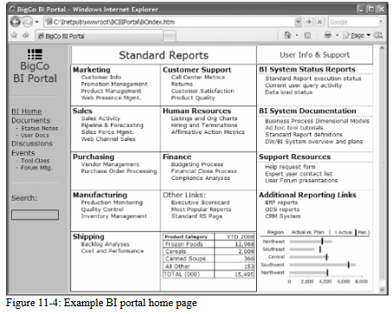
Example of BI

Slide 39
Navigation Structure Based on Business Processes
A navigation structure based on business processes is designed to align with the flow of an organization’s operations, making it intuitive for users to access the information and tools they need. Here are some key aspects and benefits of this approach:
Key Aspects
Process-Centric Design: The navigation is organized around key business processes rather than traditional departmental or functional divisions. This means users can follow a logical flow that mirrors how tasks are performed within the organization¹.
End-to-End Process Visibility: Each process is mapped out from start to finish, providing a clear path for users to follow. This helps in understanding the sequence of activities and their interdependencies¹.
Role-Based Access: Navigation can be tailored to different user roles, ensuring that employees have quick access to the tools and information relevant to their specific tasks

Slide 40
Navigation Structure Based on Business Processes
Implementation Steps
Identify Key Processes: Start by mapping out the core business processes that drive your organization. This includes understanding the inputs, outputs, and key activities involved¹.
Design the Navigation Flow: Create a navigation structure that reflects the sequence of these processes. Ensure that each step is clearly defined and accessible¹.
Test and Refine: Implement the navigation structure and gather feedback from users. Make adjustments as needed to improve usability and efficiency

Slide 41
Navigation Structure Based on Business Processes
Key Additional Functions
User Authentication and Authorization: Ensures secure access to the portal by verifying user identities and assigning appropriate access levels¹.
Content Management: Allows for the creation, editing, and management of content within the portal, making it easy to keep information up-to-date¹.
Collaboration Tools: Features like discussion forums, chat, and document sharing facilitate collaboration among users¹.
Personalization: Customizes the user experience based on individual preferences and roles, providing relevant content and tools¹.
Analytics and Reporting: Integrates with BI tools to provide real-time analytics and reporting capabilities directly within the portal¹.

Slide 42
Navigation Structure Based on Business Processes
Key Additional Functions
Workflow Automation: Automates routine tasks and processes, improving efficiency and reducing the potential for errors¹.
Mobile Access: Ensures that the portal is accessible from mobile devices, allowing users to access information and perform tasks on the go¹.
Search Functionality: Provides robust search capabilities to help users quickly find the information they need¹.
Notifications and Alerts: Keeps users informed about important updates and events through email, SMS, or in-app notifications¹.
Integration with External Systems: Allows the portal to connect with other enterprise systems, such as CRM, ERP, and HRM, for seamless data exchange¹

Slide 43
Application Interface Alternatives
Direct tool-based interface.
You can simply develop a set of reports and provide them to the users directly using the standard data access tool interface.
If your tool does not have a built-in, shared report repository capability, it is possible to create a simple file structure on the network to match the navigation path. This is not very flexible, but it is fast, and might be a good place to start while you experiment with other options

Slide 44
Application Interface Alternatives
Custom-coded interface.
Many data access tools provide APIs, and in some cases full software development kits (SDKs), to allow you to develop your own interface which then invokes the core tool functionality and displays the resulting report elements.

